Slide 1
Adherence to Diabetes Treatments in Rural and Urban Areas of Nebraska
Zak Lippert
Xavier University

Slide 2
Background: Nebraska Health
Rural residents account for 15% of Americans and 34% of Nebraskans(RHIH, 2021)
Challenges to obtaining health services can be personal and systemic
Location, religious beliefs, illness knowledge, cultural beliefs, self efficacy
Physician Density in rural Nebraska is a fraction of urban Nebraska
.009 doctors/ square mile compared to 0.169 doctors/ square mile(HRSA, 2021)
Residents per physician is very similar
1239 residents/ physician compared to 1390 residents/ physician(HRSA, 2021)
Certain rural counties look more like urban counties in terms of density

Slide 3
Background: Diabetes
Diabetes affects 34 million Americans and 170,000 Nebraskans(CDC, 2021)
These numbers exclude prediabetes, an early sign of elevated blood sugar
Total health care for diabetics costs 2.3 times the cost without diabetes(ADA, 2016)
In Nebraska, diabetes was the 7th highest cause of death in 2017
Proper care and management can prevent or shorten hospital stays and reduce healthcare costs(Curtis, et al, 2017)

Slide 4
Background: Krass, 2014
Type 2 diabetes adherence rates between January 2004 and July 2013 had a wide range(38.5%-93.1%)
High adherence was rare, only 6 studies out of 27 reached over 80%
‘Adherence’ doesn’t have a single universally accepted definition
Depression and costs contributed to lower rates of adherence

Slide 5
Background: Shahin, 2019
Adherence factors can come from personal or cultural sources
5 parts of personal belief: Identity, timeline, consequences, control, and cause
Patient belief, how much they think they can control or beat the disease, is highly impactful
Patients with multiple cultures influencing their beliefs had more positive outcomes
Factors can be sorted into unmodifiable(age) and modifiable(education)

Slide 6
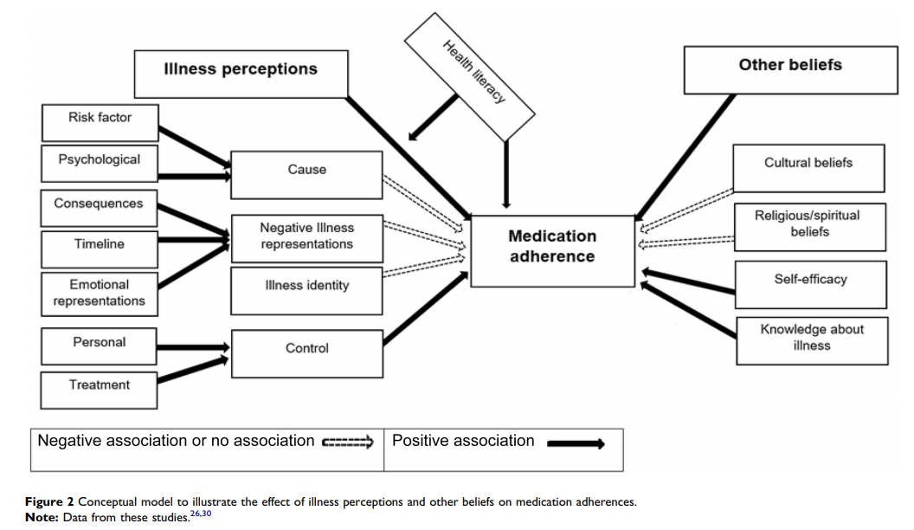
Adherence Factors(Shahin, 2019)

Slide 7
Objective
Do diabetes patients in rural Nebraska adhere to the standard of care at the same rates as urban patients?

Slide 8
Methods: Data
Blue Cross Blue Shield of Nebraska claims for ‘diabetes’ between 2014 and 2019
At least 21 by 2014 and no older than 75 at the point of care
Follow-up claims measured by ‘diabetes’ claims post diagnosis, general appointment codes or joint pain, gout, arthritis, or nephropathy, all of which are comorbidities
Vision claims post diagnosis
Medical and vision records kept separate and measured separately
Patient zip codes were grouped by USDA Rural-Urban Commuting Codes

Slide 9
Methods: Conditions
Separate adherence rates for vision and medical claims were used, no crossover
Adherence was measured against 1 appointment per year and 2 appointments per year
When testing adherence at 2 appointments per year, it was still measured as 0 for unsuccessful and 1 for successful, no .5 adherence possible for ½ appointments
Rural was labeled as a 7 or higher on the RUCA table
At most, small town core with primary flow to small urban cluster

Slide 10
Methods: Calculation
The first year a patient had a diabetes diagnosis was labeled their diagnosis year
Each following year was a treatment year
Patients could either be successfully treated in a year(1) or unsuccessfully(0)
[Years with appointment(s) post diagnosis/Total Years post diagnosis] = Adherence
A two-sided t-test was used to determine the difference between the means was significant

Slide 11
Results
The results difference between rural and urban adherence for 1 appointment per year, 2 appointments per year, and vision were all significant at the 95% confidence level
Urban patients are adhering to the standard of care at a higher rate that rural residents
 | Population Size | 1/Yr | 2/Yr | Vision
Rural | 33486 | 0.7563 | 0.6414 | 0.1098
Urban | 119564 | 0.7646 | 0.6751 | 0.1158
Difference |  | 0.0083 | 0.0337 | 0.006
Confidence Interval |  | [.0044, .0122] | [.0294, .0381] | [.0033, .0086]
Significance Level |  | 95% | 95% | 95%

Slide 12
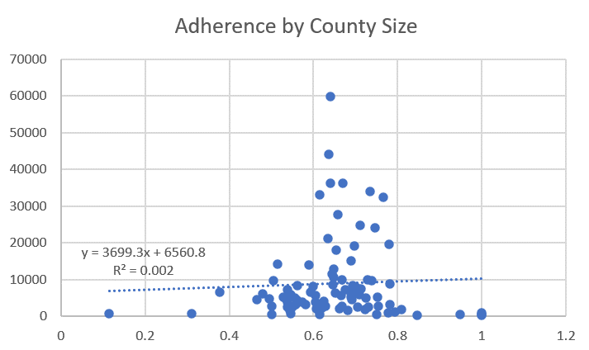
Adherence by County Size(counties over 100,000 people removed as outliers)

Slide 13
Limitations
Data was only collected from BCBSNE members who had claims, leaving out non-members and people with diabetes, but no claims
Follow-up visits were only measured using select comorbidities and diagnostic test codes, leaving out dozens of other reasons for visits
The data only captures a small window of diagnoses, long term maintenance is unclear from this study
Vision records are sometimes billed through vision only insurance and won’t show up with this data, artificially lowering vision adherence from where it would be

Slide 14
Conclusions
Adherence is lower among rural residents, but not by a lot
Not to point where a rural focused intervention would be cost effective in closing the gap
Urban counties had a very small range of adherences, 58% to 78%
Rural counties had a range of 11% to 100%
Interventions could be targeted to certain rural counties that are performing poorly
Future research could be done on what makes the worst performing areas different and how to address those factors

Slide 15
References
CDC. About Rural Health. 2017. Accessed at: https://www.cdc.gov/ruralhealth/about.html
Rural Health Information Hub. 2021. Accessed at: https://www.ruralhealthinfo.org/states/nebraska#:~:text=Nebraska%20covers%2076%2C872%20square%20miles,areas%20(USDA%2DERS).
HRSA. Defining Rural Populations. 2021. Accessed at: https://www.hrsa.gov/rural-health/about-us/definition/index.html
ERS. Rural-Urban Commuting Codes. 2021.Accessed at: https://www.ers.usda.gov/data-products/rural-urban-commuting-area-codes.aspx
CDC. National Diabetes Statistics Report, 2020. 2020. Accessed at: https://www.cdc.gov/diabetes/library/features/diabetes-stat-report.html#:~:text=34.2%20million%20Americans%E2%80%94just%20over,Asians%20and%20non%2DHispanic%20whites
American Diabetes Association. The Burden of Diabetes in Nebraska. 2016. Accessed at: http://main.diabetes.org/dorg/PDFs/Advocacy/burden-of-diabetes/nebraska.pdf
Curtis, S., et al. Medication Adherence and Improved Outcomes Among Patients With Type 2 Diabetes. American Journal of Managed Care. 2021. https://www.ajmc.com/view/medication-adherence-and-improved-outcomes-among-patients-with-type-2-diabetes
Health Resources and Service Administration. Data Explorer. https://data.hrsa.gov/tools/data-explorer
Division of Public Health. Nebraska Health Disparities Report. 2020. Office of Health Disparities and Health Equity. https://dhhs.ne.gov/Reports/Health%20Disparities%20Report%202020.pdf
Krass, I., Schieback, P.,Dhippayom, T. Adherence to diabetes medication: a systematic review. Diabetic Medicine. 2014. https://doi.org/10.1111/dme.12651
Care Management Team, BCBS Nebraska. On Diabetes, treatments and obstacles to care. 2021.
CMS. Healthcare Effectiveness Data and Information Set (HEDIS). 2021. Accessed at: https://www.cms.gov/Medicare/Health-Plans/SpecialNeedsPlans/SNP-HEDIS
Blue Cross Blue Shield Illinois. HEDIS Tip Sheet 2021. 2021. Accessed at: https://www.bcbsil.com/pdf/clinical/bcchp_hedis_chronic_conditions.pdf
Shahin, W., Kennedy, G., Stupans, I. The impact of personal and cultural beliefs on medication adherence of patients with chronic illnesses: a systematic review. Patient Preference and Adherence. 2019. DOI:10.2147/PPA.S212046
American Diabetes Association. Diabetes and Your Joints. Clinical Diabetes Jul 2001, 19 (3) 136; DOI: 10.2337/diaclin.19.3.136
Enroll Nebraska. The Uninsured in Nebraska. 2019. Accessed at: https://enroll-ne.org/uninsured

